Slide 1
HORSEBACK RIDING DAILY & MULTIDAY TRIPS

Slide 2
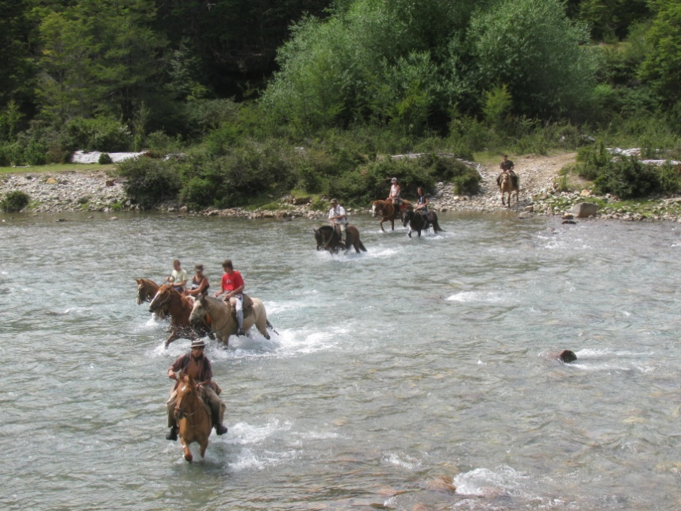
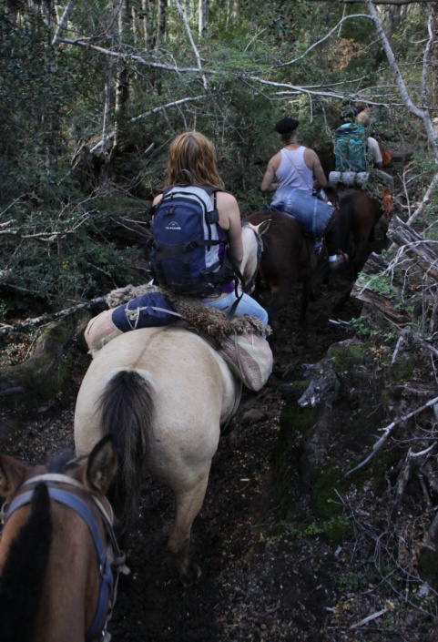
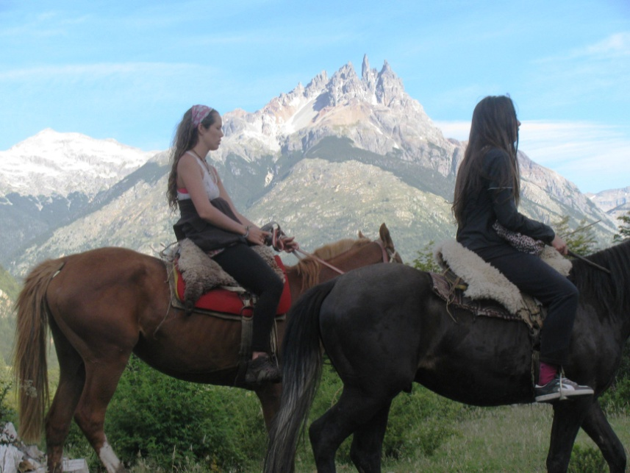
In the Azul Valley , we have different nice routes for horseback riding, between snowy peaks and majestic landscapes . Horseback rides from 1 day or more days , depending on what the customer wants.
Ask for tours.

Slide 3
Fico Gallese
+51 984638855
Pascua Pithod
+54 9 2613451188
+51 974365017
info@puravidaexpediciones.com
www.puravidaexpediciones.com

